Slide 1
Video URL
Artemis_concrete architecture.mp4

Slide 2



Artemis
CISC-322 Group 14
Adrian Chu* | 18anhc@queensu.ca
Alex Baldassare | 18cab16@queensu.ca
Randy Bornstein* | 18rjb10@queensu.ca
Jake Halay** | 15jmh9@queensu.ca
Kashish Khandelwal | 20kmk3@queensu.ca
*Presenters **Group Leader
Notes:
Randy

Slide 3
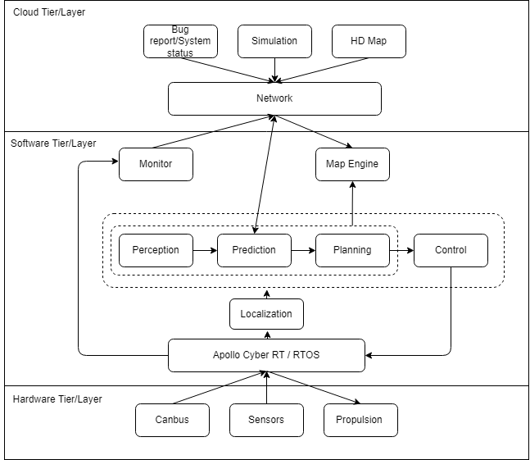
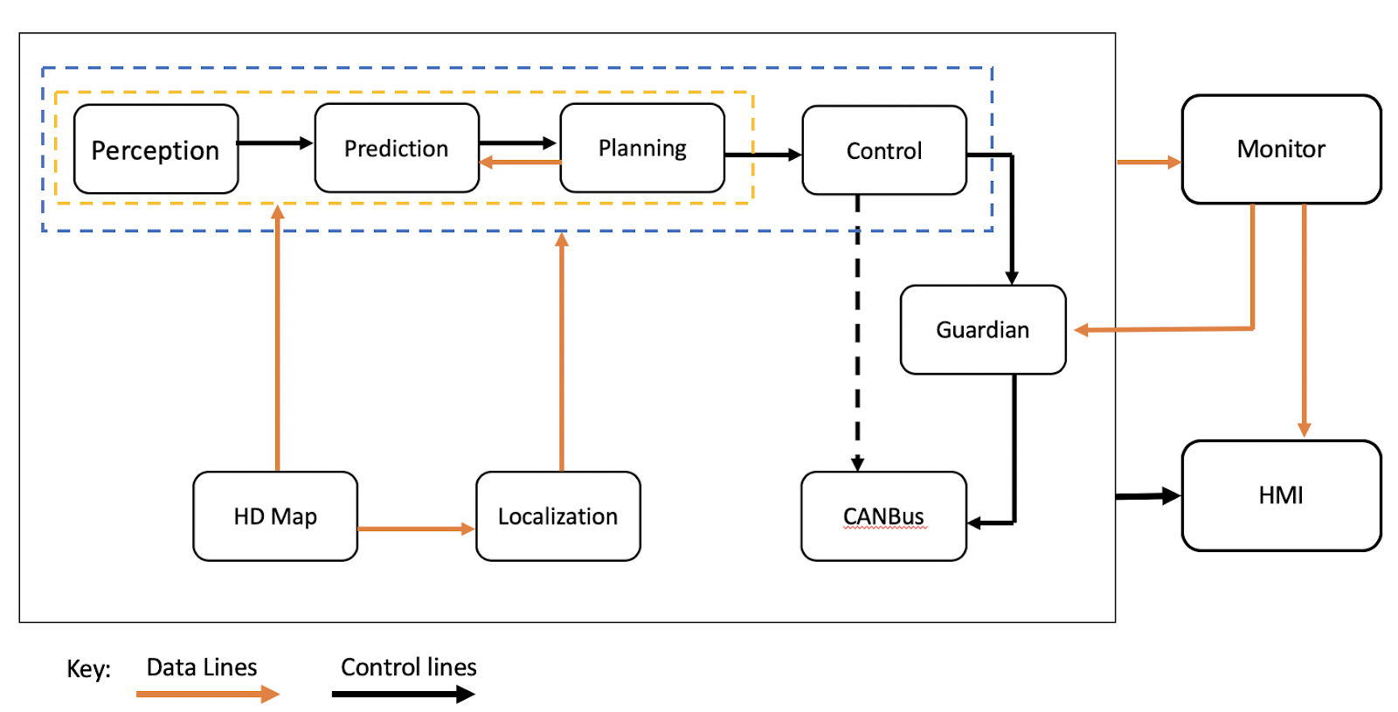
Recap: conceptual architecture
Layered-style
Publish-Subscribe style
Notes:
Adrian

Slide 4
Derivation process
Scrapping out initial idea
Understand 5.1
Apollo’s GitHub repository
Expanding use case components and interactions
Notes:
Adrian

Slide 5
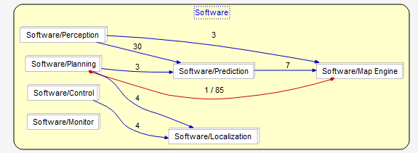
Internal dependencies found in conceptual architecture
Notes:
Adrian

Slide 6
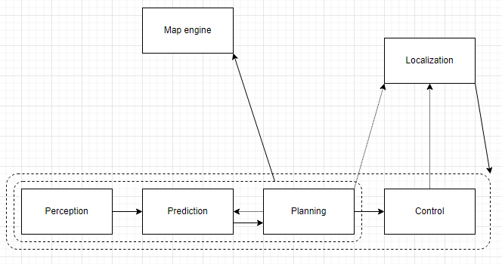
Finalized concrete architecture
Notes:
Adrian

Slide 7
Reflexion analysis
Divergencies found
Interactions between Prediction and Planning are one-directional
Localization component being substantially utilized
Decision-making made crucial
Notes:
Adrian

Slide 8
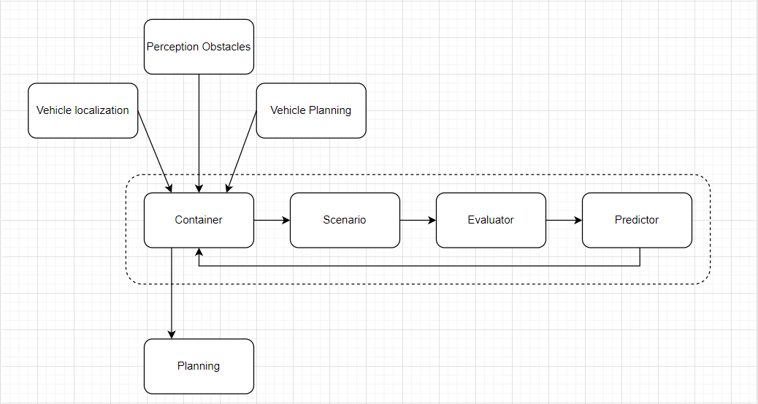
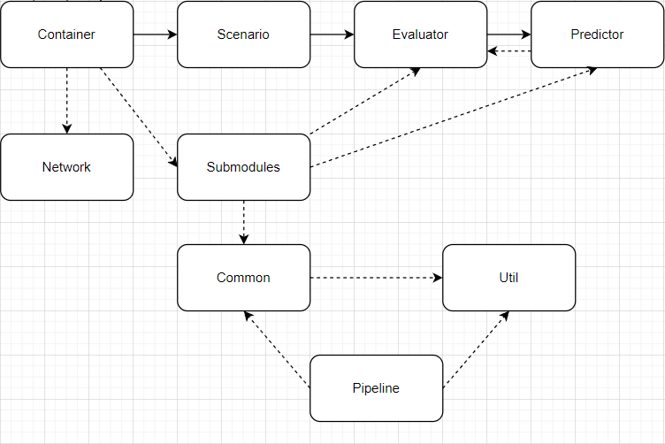
2nd level subsystem - Prediction module analysis
Conceptual
Concrete
Notes:
Adrian

Slide 9
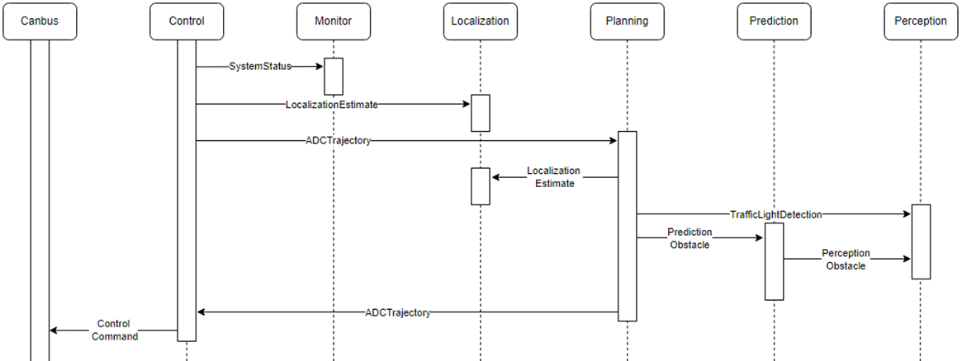
Use cases
1. Traffic light detection – Publish Subscribe
Notes:
Randy

Slide 10
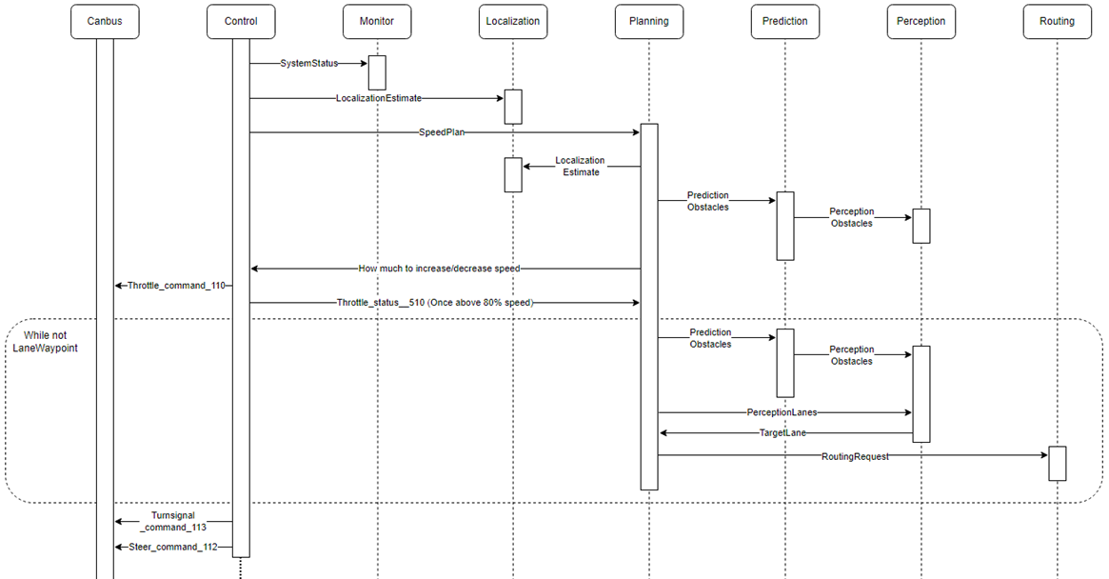
Use cases
2. Speed control when merging onto a highway
Notes:
Randy

Slide 11

Lessons learned
Understand ^{®™©SM}
Vital role
Frequent problems
Missing dependencies
Language familiarity
C++, Proto3, etc.
Notes:
Randy

Slide 12

-Thank you-

